Slide 1


Slide 2
The Scenario
In this scenario, we are in the position of either a new firm that has just opened a marketing department or an established firm looking to market a new product for which we have no prior data and are thus relying on industry data.
We must decide how much money to spend in each channel to maximize our desired KPI.

Slide 3
The Scenario
We have a limited budget and no previous data from our organization, but we have industry data. Our goal is to estimate how different strategies/allocations affect various KPIs.
There are many potential sources of uncertainty, namely that we do not know how a particular campaign will perform, as well as the variation in the industry data.

Slide 4
Data and Assumptions
We used an industry dataset obtained from kaggle. The data was clean with no nulls, extreme outliers, or other concerning artifacts.
It can be accessed here: Marketing Campaign Performance Dataset
Assumptions:
The industry data can be used to predict our own performance.
There is no ‘data drift’ in the sense that it may be outdated.
(Hidden Cleaning - the data was synthetic and lazily made, so we added some variation to the variables to make this project interesting)

Slide 5
Prescriptive Analytics Models
The first technique used is linear programming/optimization. The second is simulation. The decision variable is the percent allocation towards each marketing channel.
The simulation aspect is realized when the optimization model draws the relevant parameters from the approximated distributions. For example, there is no singular cost for email campaigns; they are generated each time from a parametrized distribution based on the data. The objective function is a weighted average of the relevant KPIs, which are also drawn stochastically, as are the costs.
The major constraint is the minimum 5% allocation towards each channel. We believed this was reasonable, given that it is likely firms will have at least some activity on the channels available to them. There is also the total budget constraint, though it is largely irrelevant for decision-making given the nature of the problem, as we will see shortly.
The advantage of merging these approaches is that the variability of the underlying variables is handled naturally through simulation, whereas standalone optimization would be deterministic.

Slide 6
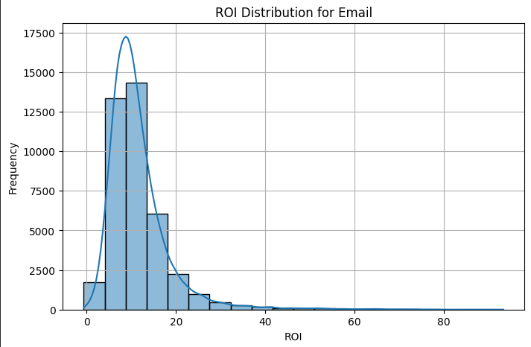
Understanding the Results
This is the actual distribution for one of the KPIs from our data. We estimate the best fitting probability distribution and associated parameters, then sample from that for the simulation. Due to the nature of the objective function and the minimum 5% constraint, there will be various channels that are ‘winners’ more often than others, and some which will more often be assigned to the 5%. Obviously costs affect this process in the same way.

Slide 7
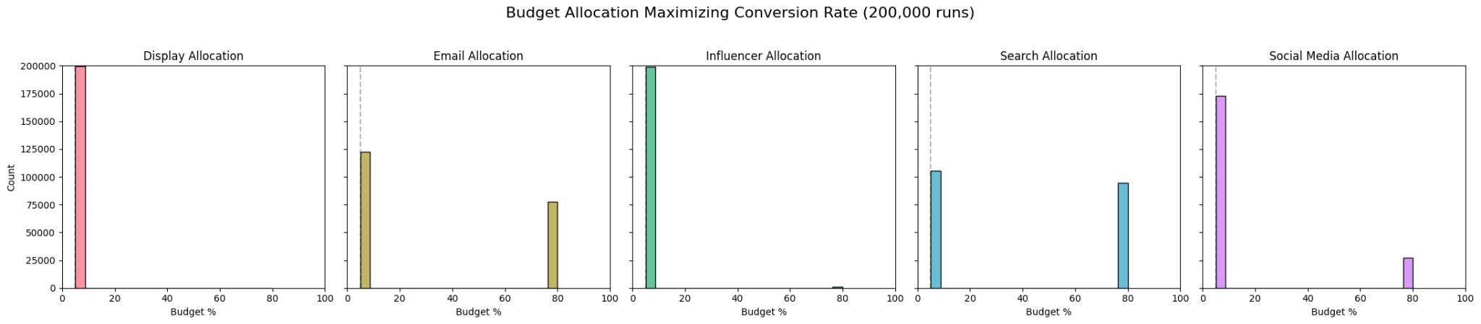
Understanding the Results
The resulting distributions are incredibly bimodal. This should be expected, as some channels will - depending on stochastic variation on the draws - have more contribution to the objective in a given trial, and be given the priority over the other ones which drew more poorly that trial with regard the relative strengths of their costs and contributions to the KPI. Here, Display is a clear loser, never being the ‘dominant’ allocation in any of the trials.

Slide 8
Understanding the Results
Influencer and Social Media also do very poorly, often being the ‘5%’ choices. It is email allocation and search allocation which are fighting for dominance, with Search slightly edging out.

Slide 9
Results & Analysis
This leads to the conclusion that, optimizing for Conversion Rate, the best decision would be budget allocation 80% to Search, and 5% to the rest.

Slide 10
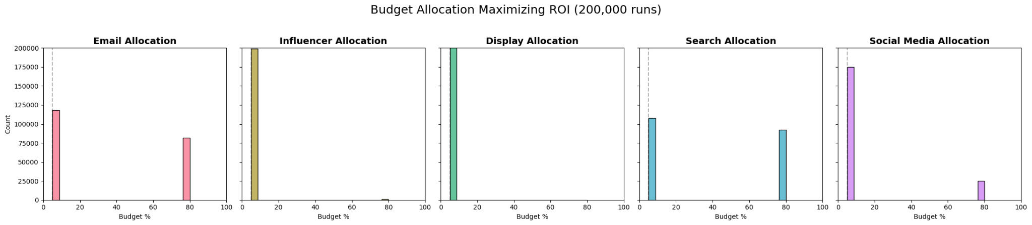
Results & Analysis
In the case of optimizing for ROI, the best plan of action would be to give 80% of the budget towards Search results, although an Email campaign focus would not be unwarranted either.

Slide 11
Results and Analysis - A Custom KPI Metric
While Conversion Rates and ROIs are important, we wanted to come up with what we believed was a better representation of product engagement, which is the ultimate goal of marketing.
We combined three specific columns: Clicks, Impressions, and Engagement Score.
We first calculated the Click-Through Rate (CTR) - Clicks / Impressions - to see what percentage of people the advertisement got to stop and click.
We next designed a metric for Quality. We multiplied the CTR percentage by the Engagement Score, which ranges from 1-10. A high CTR with a low Engagement Score (e.g., clickbait) will be penalized, while a decent CTR with a perfect 10 Engagement Score will be heavily rewarded.
The end result is a more rounded metric which estimates how many "Engagement Points" the company gets for its advertisements through a given channel.

Slide 12
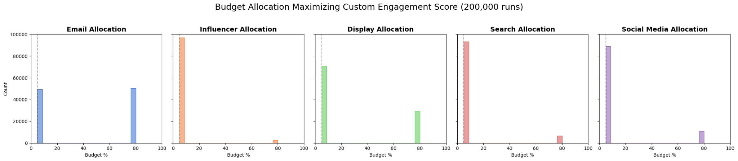
Results & Analysis
In this final case, Email Campaigns emerge as a clear winner for the dominant budgetary role.

Slide 13
Strengths and Limitations
The major strength of this approach is that it naturally handles the data's variability through simulation. On its own, an optimization model is deterministic. However, since the values are drawn from distributions approximated from the data, the final distributions of the allocations account for the stochastic element.
The major limitation is specificity. There is no guarantee that the industry-level data will translate well to our own marketing campaign. Additionally, we do not know which ad campaigns in the data advertised a product similar to the one we are promoting, which we would have ideally focused on.
Even if we had this data, there is still no guarantee that the conditions under which it was collected would remain consistent in our time - even a change in consumer tastes could make this approach irrelevant.

